Slide 1
Allnex
Crater prevention training for suppliers
Allnex Global Quality Team

Slide 2

Purpose
Why is this important?
Allnex has demanding customers and we’re committed to meeting their requirements. The risk of cratering in our customers formulations has impacted us in the past
This review is focused on preventing contamination in production processes, including incoming raw materials, the use of supplies and personal care products that may contaminate our product, filtration operations (the primary method for removal of contamination, and packaging operations into containers or wagons.
We are asking our suppliers to commit to partnering with us and their contractors, bulk carriers, and packaging providers in a proactive approach to prevent issues from occurring which could impact allnex

Slide 3
Learning Objectives
What are craters
How are contamination and craters linked
What causes craters
Where craters are a problem
How can we prevent craters

Slide 4
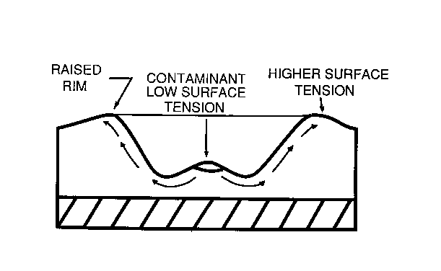
What are craters?
Craters are dish shape deformations in a paint surface that may, in extreme cases, penetrate to the layer below, typically 1 - 4 mm in diameter.

Slide 5
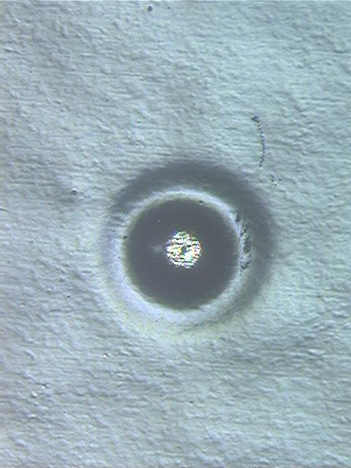
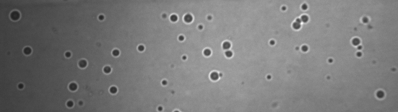
Craters
Crater
Close-Up
Test Panel of Paint with Craters

Slide 6
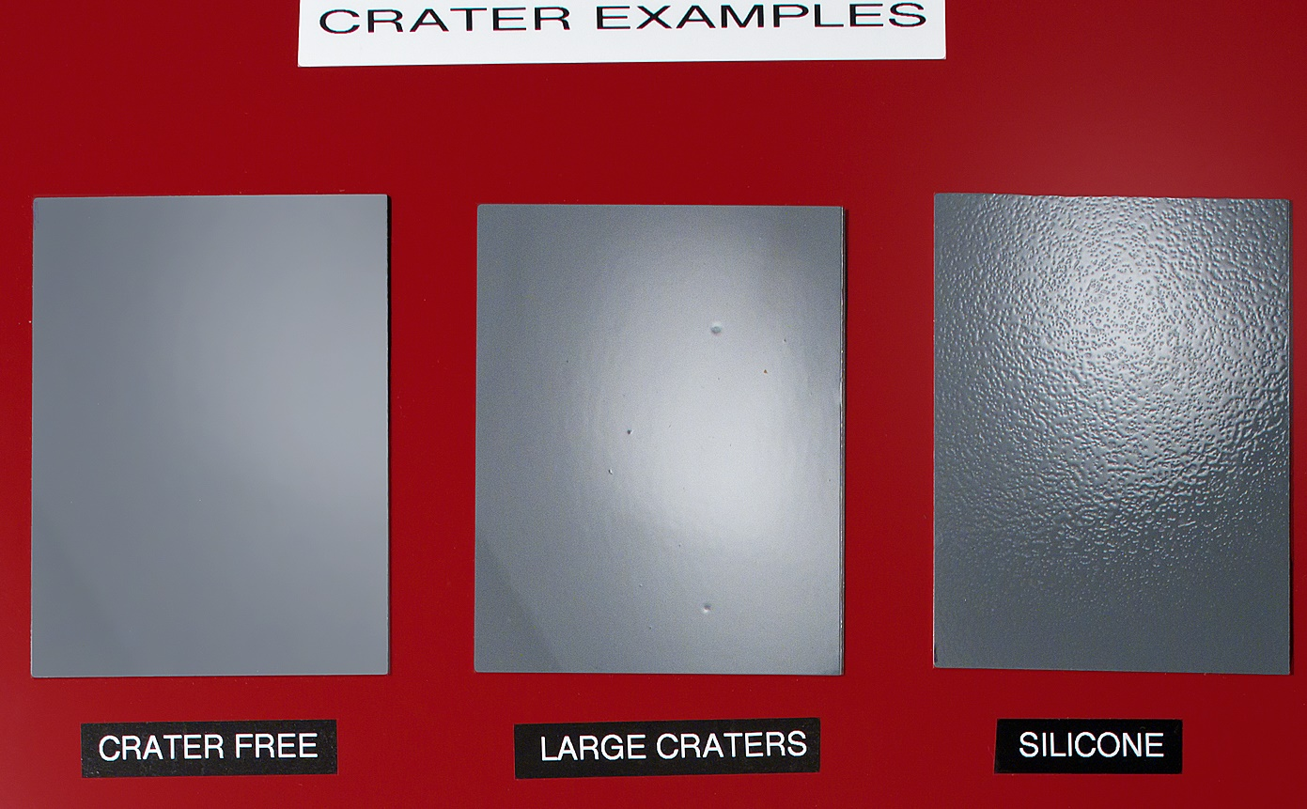
Craters

Slide 7
What Causes Craters?
Craters are caused by Contaminants which have a lower surface tension than the bulk paint
and
which are not completely dissolved in the paint during cure.

Slide 8
Causes of Craters
Low surface tension material that is insoluble
or marginally soluble in the paint
Paint
Flash
Bake
oven
As the solvent flashes off, tiny droplets or particles of low surface tension contaminant cause the paint to “de-wet” and form craters.

Slide 9
Cause of Craters
The most aggressive contaminants are
  Silicones – e.g. Poly Di Methyl Siloxane (PDMS)
  Fluoro compounds – e.g. Teflon sealants
  Sulfonates – detergents and surfactants
Silicone based compounds have increased in popularity due to the benefits in many products – lubricants, plastics, creams, lotions, etc.

Slide 10
Typical items known to cause craters
Oils, lubricants
Deodorants, hair sprays
Antiperspirants
Dirt
Fibers

Slide 11
Less than 1 ppm of a
contaminant can cause
craters!
…. about 1/2 ounce in a tank wagon
11 March 2024

Slide 12
Where Are Craters a Problem?
Automotive Paints are the application where Craters are most problematic.
The auto makers want a maximum of 1 crater in 25 cars = 3000 sq. ft. of surface.

Slide 13

BIGGEST Cost of Craters
Loss of customer confidence in Allnex as a supplier
Loss of business to Allnex
Loss of business to our suppliers

Slide 14
Craters can be prevented by Controlling:
  Raw Material quality
  Maintenance materials
  Processing Materials
  Process Conditions
  Packaging materials or bulk transport containers and their washing
  Miscellaneous Materials
  Essentially, anything that can come in contact with a product that is not intended to be there.

Slide 15

High Risk Area – Processing Equipment
Silicone infused thread was used to sew filter bags
Filter bag manufacturer changed thread without notification
Silicone in thread from filter leached into thousands of gallons of resin
Resin was used in Customer’s paint and caused severe craters in their customers’ automotive plants
Four months of investigative work was done to isolate the cause

Slide 16
Maintenance materials
Lubricants
Part cleaners
Sealants
Gaskets

Slide 17
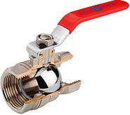
High Risk Area – Processing Equipment
New valves lubricated with silicone
Solvent supplier upgraded their tank farm to add an inline filter system that incorporated five new valves
Valve manufacturer had standard procedure of lubricating valves in silicone before packaging
Solvent from upgraded system was used in clear coat paint, causing craters on automotive lines
Two automobile assembly lines were shut down for almost two days

Slide 18
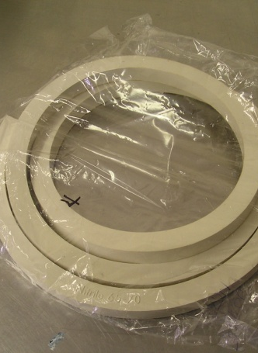
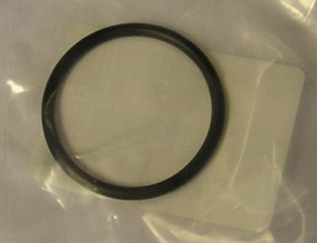
HIGH Risk Area – Processing Equipment and Ancillaries
Valves, Gaskets, Seals, Packing
New gaskets were installed at the tote station. The gaskets contained silicone and contaminated the entire tote.
New packing was installed on leaking pumps, and no crater testing was completed. All products that passed through the pumps showed low level craters. The rope packing listed silicone on the MSDS and the completed testing failed severely for craters.

Slide 19
High Risk Area – Tank Wagons
Prior Contents – Prohibited Resin (Example)
Tank wagon was filled with solvent, but prior contents in tank wagon was a resin which impacted allnex product
Gels from resin remained after tank wagon cleaning that leached into the solvent
Solvent charged into a batch of product for Automotive use. Batch packaged into a bulk transport. Sample of bulk transport failed QC testing for craters and was rejected
Contaminated solvent was added to bulk tank system. Tank had to be quarantined and completely cleaned out.
Other often overlooked element of bulk container washing.
Cleaning facility services companies that manufacture silicone based materials, and they recycle/re-use the cleaning agent for a period of weeks or months. One cleaning of a silicone/surface active containing bulk container will create opportunities to contaminate multiple bulk wagons as silicone is not digestible and not soluble in water

Slide 20
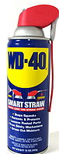
High Risk Area – Maintenance Materials
Products that scare us!
WD-40 widely used but causes craters
Silicone –caulk, adhesives, lubricants
Greases with low surface tension components
Recommendation: Review prohibited list before using any new maintenance material or lubricant or grease on production equipment that touches product, especially after filtration

Slide 21
High Risk Area – Personal
Personal Care Items
Over 50 hand lotions were tested for craters - 95% failed crater testing
Ingredients to avoid: dimethicone or simethicone
Many toiletries have large amounts of silicone (hair products, deodorants, etc.) – excessive amounts near automotive production lines have caused craters

Slide 22
Recommendations – Personal Care Products
Personal Care Items
Ensure soaps and lotions used in manufacturing, maintenance and equipment cleaning areas are the brands that do not cause craters
Review manufacturing, maintenance and equipment cleaning processes for potential contact with excessive amounts of personal care items (hair products, deodorants, etc.)

Slide 23
Recommendations
Personal Influence on Contamination avoidance
What can I do as a supplier to help allnex.
Look out for any new items which are brought into your facility that could come in contact with the product.
Ask or challenge if maintenance items which can come in contact with your product contain silicone or siloxane materials
Be aware of bulk container last contents, and the nature of the chemicals serviced through your preferred bulk carrier washing facility. You may need to partner with your carrier and engage them as well.
Use dedicated wagons for allnex where possible.
Pay particular attention to items used in filtration and packaging, as it is the last line of defense before the material reaches allnex

